Slide 1
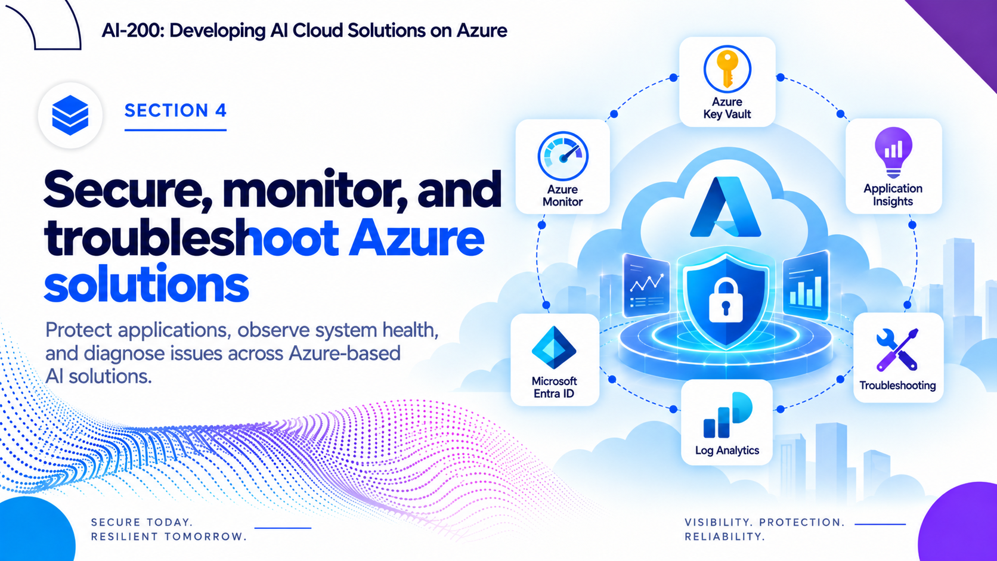


Slide 2
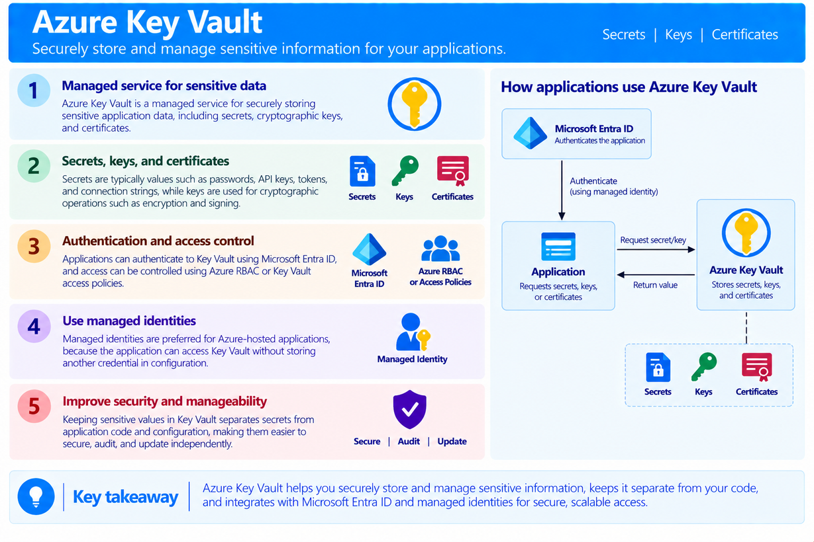
Azure Key Vault
  Azure Key Vault is a managed service for securely storing sensitive application data, including secrets, cryptographic keys, and certificates.
  Secrets are typically values such as passwords, API keys, tokens, and connection strings, while keys are used for cryptographic operations such as encryption and signing.
  Applications can authenticate to Key Vault using Microsoft Entra ID, and access can be controlled using Azure RBAC or Key Vault access policies.
  Keeping sensitive values in Key Vault separates secrets from application code and configuration, making them easier to secure, audit, and update independently.

Slide 3
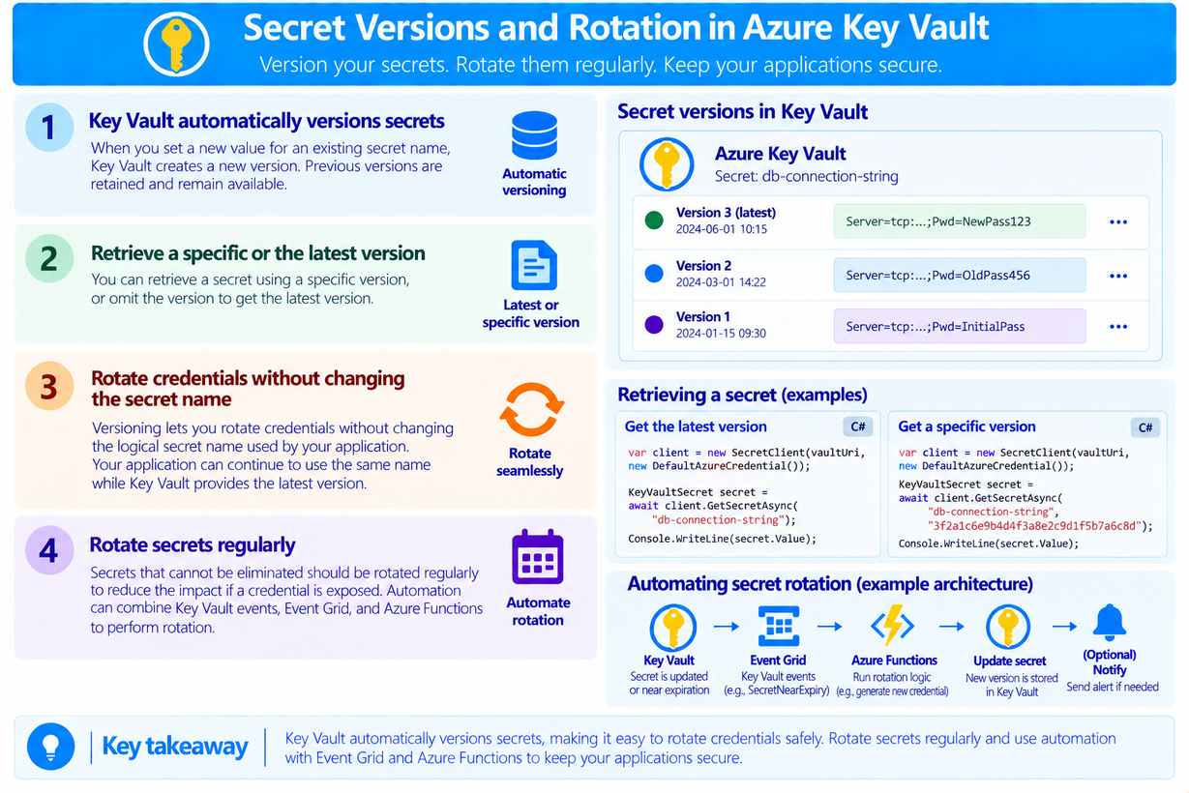
Secret Versions and Rotation
  Key Vault automatically versions secrets. Setting a new value for an existing secret name creates a new version, while previous versions remain available.
  A secret can be retrieved using a specific version, or the version can be omitted to retrieve the latest version.
  Versioning makes it possible to rotate credentials without changing the logical secret name used by the application.
  Secrets that cannot be eliminated should be rotated regularly to reduce the impact if a credential is exposed; automation can combine Key Vault events, Event Grid, and Azure Functions to perform rotation.

Slide 4
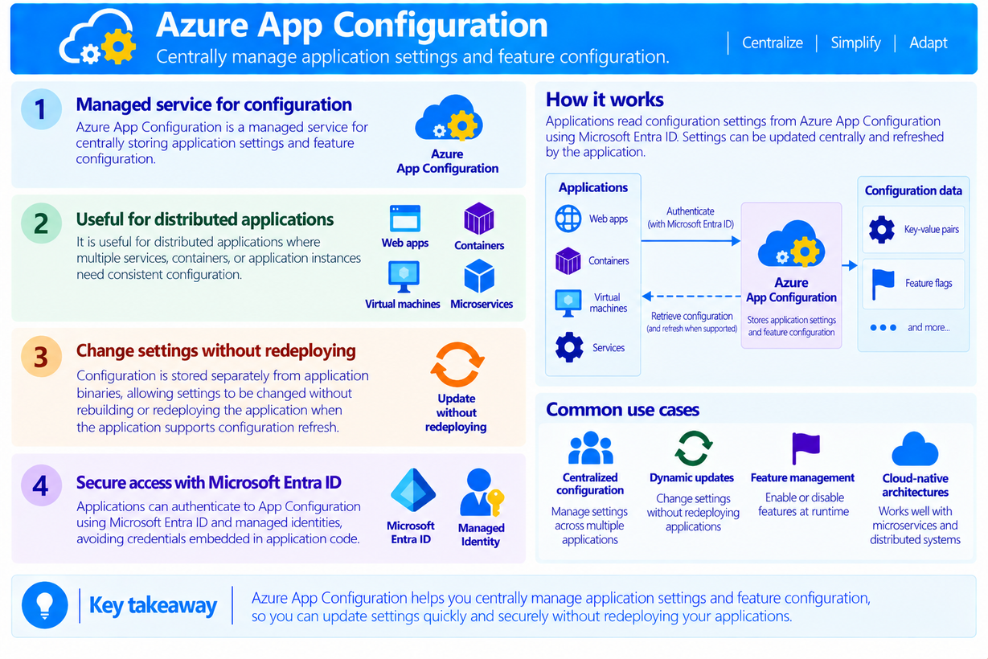
Azure App Configuration
  Azure App Configuration is a managed service for centrally storing application settings and feature configuration.
  It is useful for distributed applications where multiple services, containers, or application instances need consistent configuration.
  Configuration is stored separately from application binaries, allowing settings to be changed without rebuilding or redeploying the application when the application supports configuration refresh.
  Applications can authenticate to App Configuration using Microsoft Entra ID and managed identities, avoiding credentials embedded in application code.

Slide 5
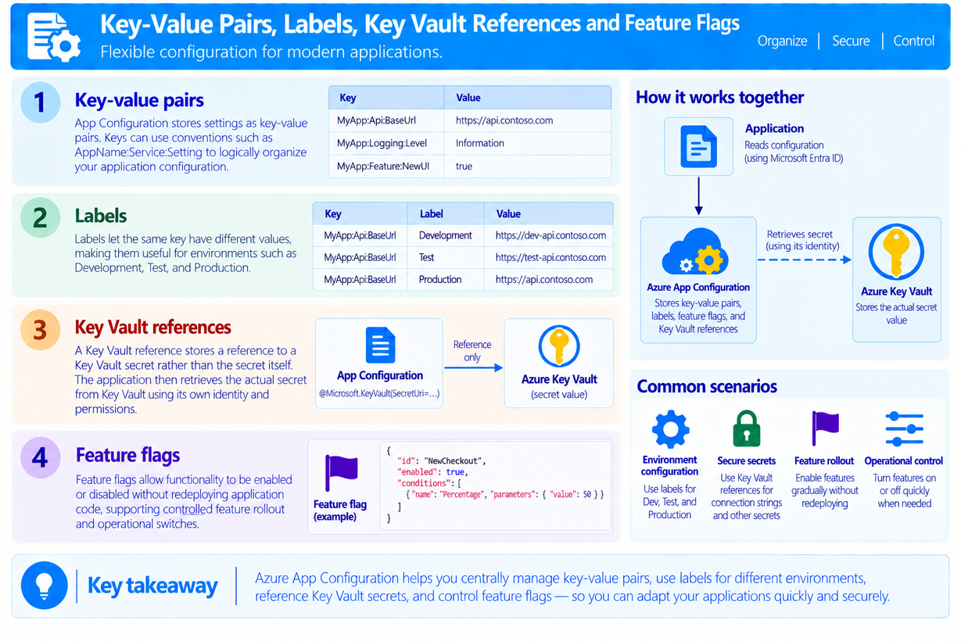
Key-Value Pairs, Labels, Key Vault References and Feature Flags
  App Configuration stores settings as key-value pairs; keys can use conventions such as AppName:Service:Setting to logically organize application configuration.
  Labels let the same key have different values, making them useful for environments such as Development, Test, and Production.
  A Key Vault reference stores a reference to a Key Vault secret rather than the secret itself. The application then retrieves the actual secret from Key Vault using its own identity and permissions.
  Feature flags allow functionality to be enabled or disabled without redeploying application code, supporting controlled feature rollout and operational switches

Slide 6
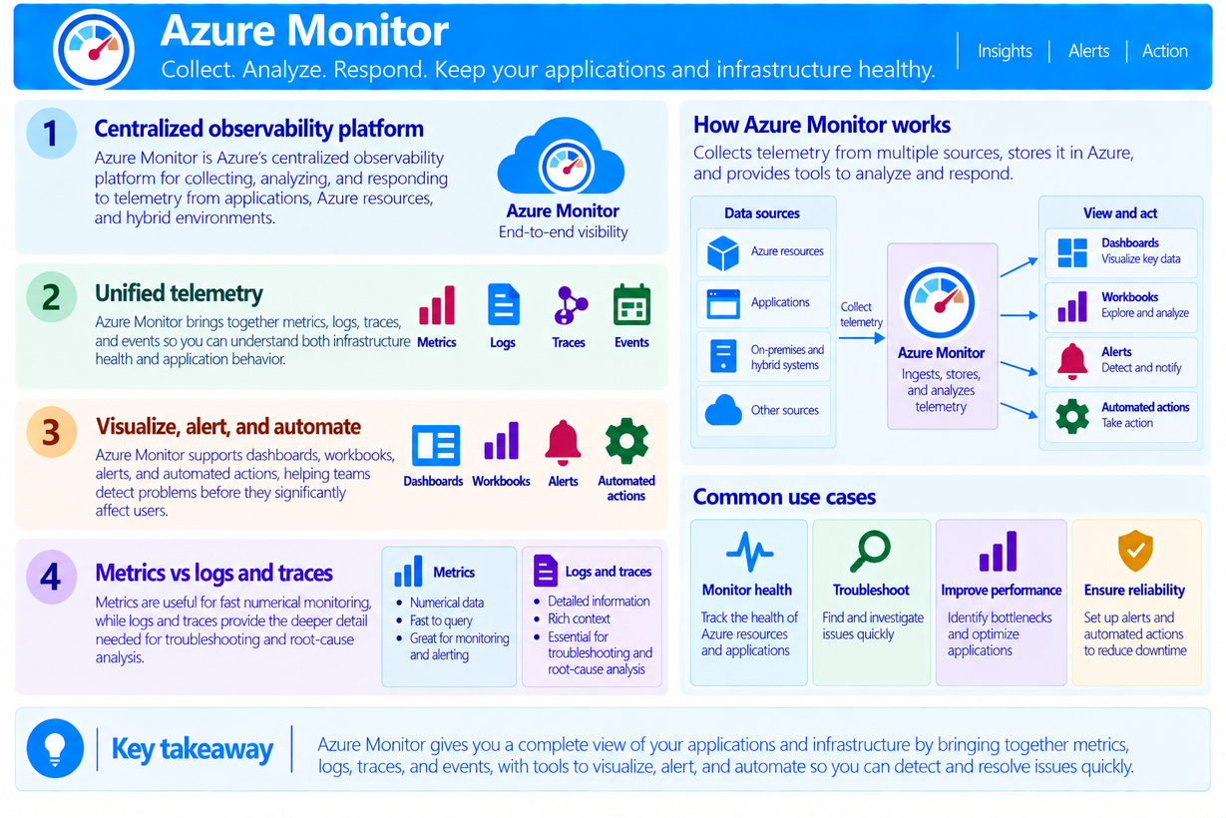
Azure Monitor
  Azure Monitor is Azure’s centralized observability platform for collecting, analyzing, and responding to telemetry from applications, Azure resources, and hybrid environments.
  It brings together metrics, logs, traces, and events so you can understand both infrastructure health and application behavior.
  Azure Monitor supports dashboards, workbooks, alerts, and automated actions, helping teams detect problems before they significantly affect users.
  Metrics are useful for fast numerical monitoring, while logs and traces provide the deeper detail needed for troubleshooting and root-cause analysis.

Slide 7
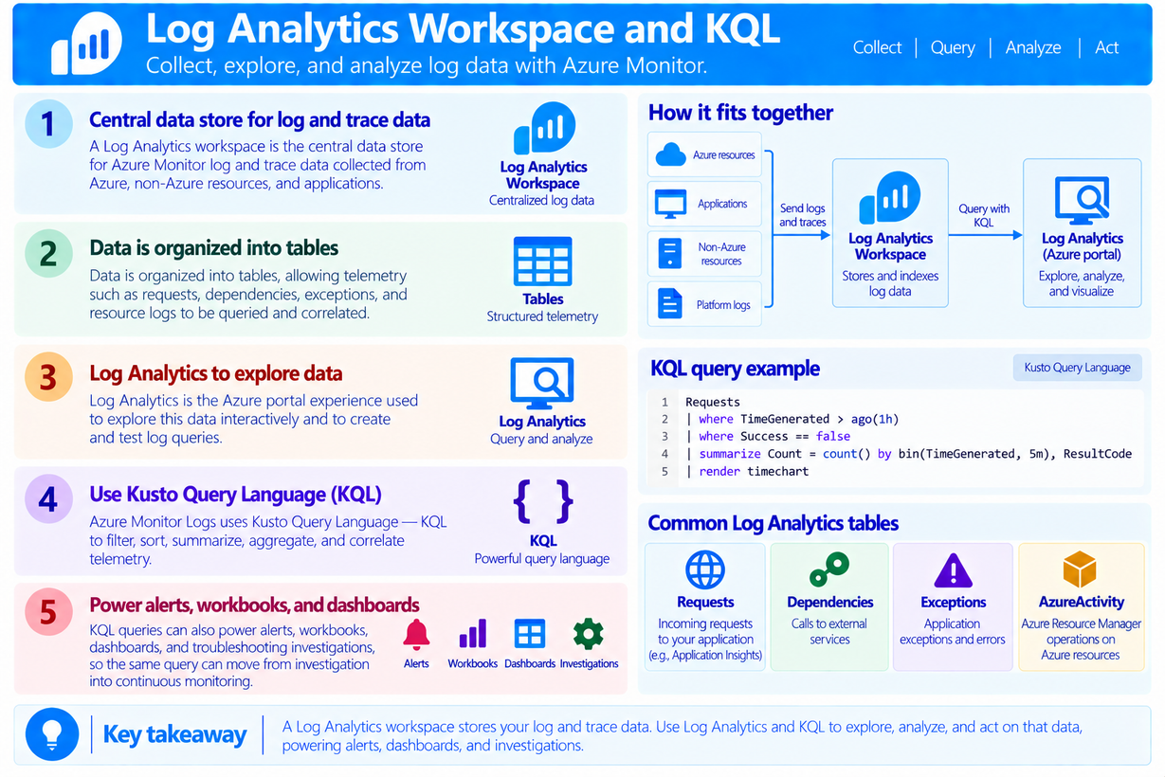
Log Analytics Workspace and KQL
  A Log Analytics workspace is the central data store for Azure Monitor log and trace data collected from Azure, non-Azure resources, and applications.
  Data is organized into tables, allowing telemetry such as requests, dependencies, exceptions, and resource logs to be queried and correlated.
  Log Analytics is the Azure portal experience used to explore this data interactively and to create and test log queries.
  Azure Monitor Logs uses Kusto Query Language — KQL to filter, sort, summarize, aggregate, and correlate telemetry.

Slide 8
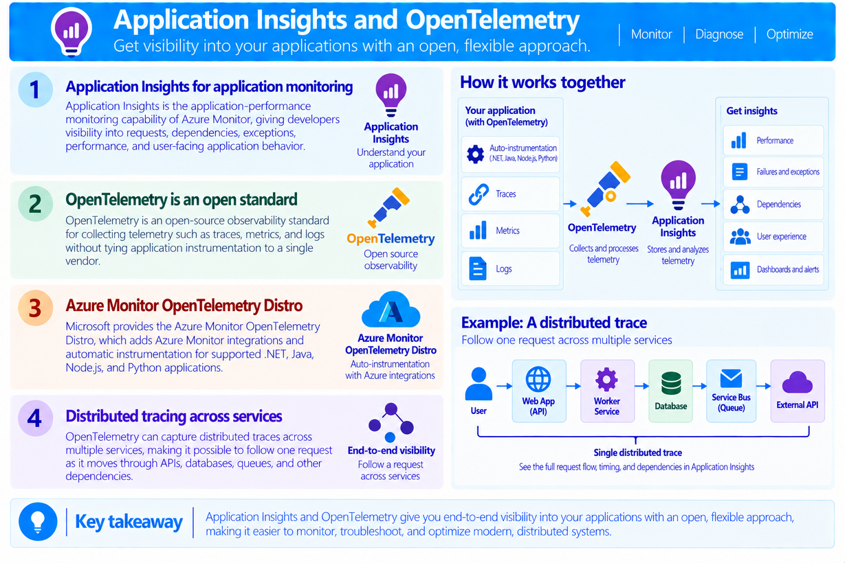
Application Insights and OpenTelemetry
  Application Insights is the application-performance monitoring capability of Azure Monitor, giving developers visibility into requests, dependencies, exceptions, performance, and user-facing application behavior.
  OpenTelemetry is an open-source observability standard for collecting telemetry such as traces, metrics, and logs without tying application instrumentation to a single vendor.
  OpenTelemetry can capture distributed traces across multiple services, making it possible to follow one request as it moves through APIs, databases, queues, and other dependencies.

